Slide 1
WELCOME

Slide 2
Fall into CME
Second annual NP/PA Education day
Last year 70 participants
This year over 140 participants
6 talks on common Pediatric specialty problems

Slide 3
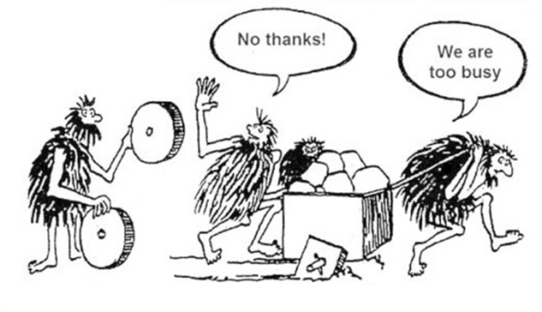
Goals for today

Slide 4
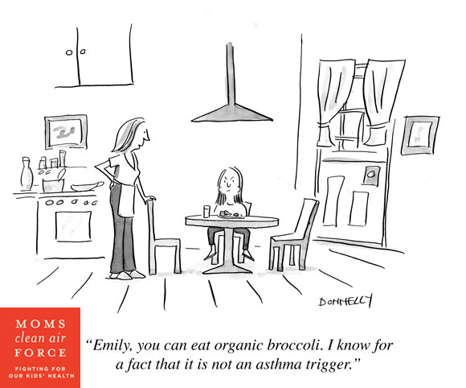
Asthma

Slide 5
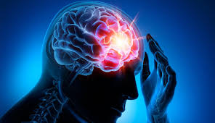
Seizures

Slide 6
Celiac Disease

Slide 7
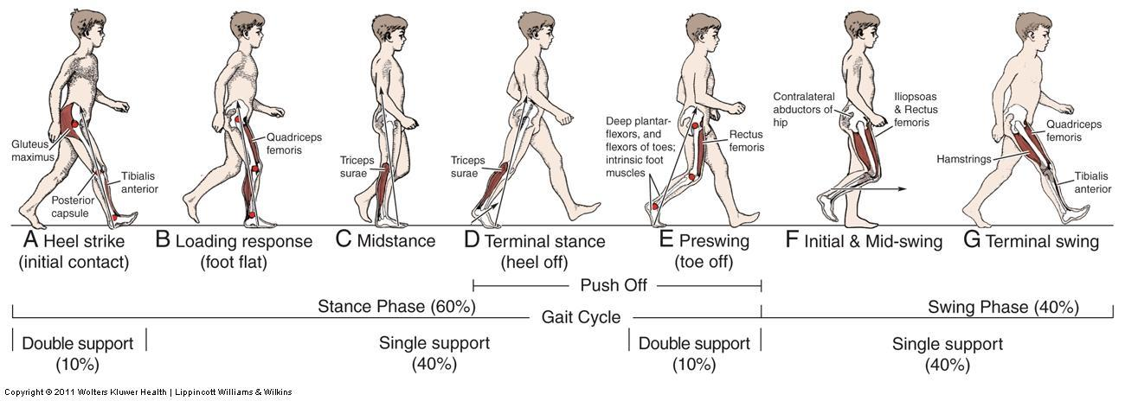
Pediatric Limp

Slide 8
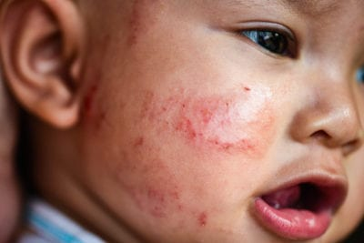
Eczema

